Slide 1
Principles of Reverse Engineering
Reverse Engineering

Slide 2
Agenda
APK
DEX Overview
Smali Code
Tools

Slide 3

Introduce APK
The package file format used by the Android operating system for distribution and installation of mobile apps and middleware.
Android Package (.APK)

Slide 4
1. APK
Introduce APK
File structure of APK
AndroidManifest.xml
Res & Assets
Resource’s Packaging Process
Native Libs
META-INF
APK’s Packaging Process

Slide 5
File structure of APK
Android’s distribution format.
Root directory may contain:
Name | Use
META-INF | Store the metadata
AndroidManifest.xml | Compiled global configuration file
assets | Store the resource file, will not be compiled: picture
classes.dex | Compiled and packaged source code
lib | Store Binary shared library: .so
res | Store the resource file: layout, string, style

Slide 6
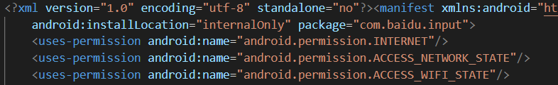
AndroidManifest.xml
An additional Android manifest file, describing the name, version, access rights, referenced library files for the application.

Slide 7
Res & Assets
The same point
The files in both directories will be saved in apk package, and will not be compiled into binary.
The different point
The file in the Res will be mapped to the R.java file, When we visit the resource we can use resource ID (R.id.filename) directly.

Slide 8
Native Libs
The directory containing the compiled code that is specific to a software layer of a processor.
The directory is split into more directories within it:
Name | Meaning
armeabi | compiled code for all ARM based processors only
armeabi-v7a | compiled code for all ARMv7 and above based processors only
arm64-v8a | compiled code for all ARMv8 arm64 and above based processors only
x86 | compiled code for x86 processors only
x86_64 | compiled code for x86 64 processors only
mips | compiled code for MIPS processors only

Slide 9
META-INF
In the META-INF, there are three files that created in the signing process:
MANIFEST.MF :
Do SHA1-summary for every files in APK.
Do BASE 64-encoding for every files in APK.
CERT.SF :
Save summary encoding value of MANIFEST.MF.
Save Digest code value for each digest item in MANIFEST.
CERT.RSA :
Save the Digital signature and Digital certificate.
Digital signature generated by encrypting CERT.SF using the key.
Digital certificate save the public key and signature algorithm.

Slide 10
APK’s Packaging Process
Application
Resources
.aidl Files
aapt
R.java
Application Source Code
Java Interfaces
aidl
Java
Compiler
.class Files
dex
3rd Party Libraries
and .class Files
.dex Files
Compiled
Resources
apkbuilder
Other
Resources
Android Package
(.apk)

Slide 11
File structure of APK
Android’s distribution format.
Root directory may contain:
Name | Use
META-INF | Store the metadata
AndroidManifest.xml | Compiled global configuration file
assets | Store the resource file, will not be compiled: picture
classes.dex | Compiled and packaged source code
lib | Store Binary shared library: .so
res | Store the resource file: layout, string, style

Slide 12
2. Dex Overview
What is Dex
Change/Code in the Process
Java Bytecode VS Dex Bytecode
Stack-Based Bytecode/ Register-based Bytecode
Multi-Dex

Slide 13
What is Dex
Dex:
DEX files are programs that run on the Android Dalvik virtual machines.
Android programs are compiled into dex files, which are in turn zipped into a single apk file on the device.
.java → .class → .dex

Slide 14
Change in the Process
Application
Resources
.aidl Files
Source Code
aapt
R.java
Application Source Code
Java Interfaces
aidl
Java
Compiler
Bytecode
.class Files
dex
3rd Party Libraries
and .class Files
.dex Files
Bytecode
Compiled
Resources
apkbuilder
Other
Resources
Android Package
(.apk)

Slide 15
Code in the Process
Source code
The code that be written according to the Java language specifications.
Extension name: .java
Bytecode
A form of instruction set designed for efficient execution by a software interpreter.
Extension name(In Android): .class/.dex
Binary code
Machine code, the result that assembly language compiled.
Extension name: .bin
Notes:
https://en.wikipedia.org/wiki/Bytecode
https://en.wikipedia.org/wiki/Binary_code

Slide 16
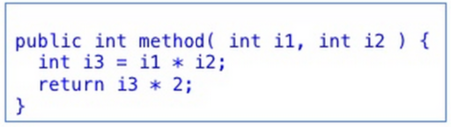
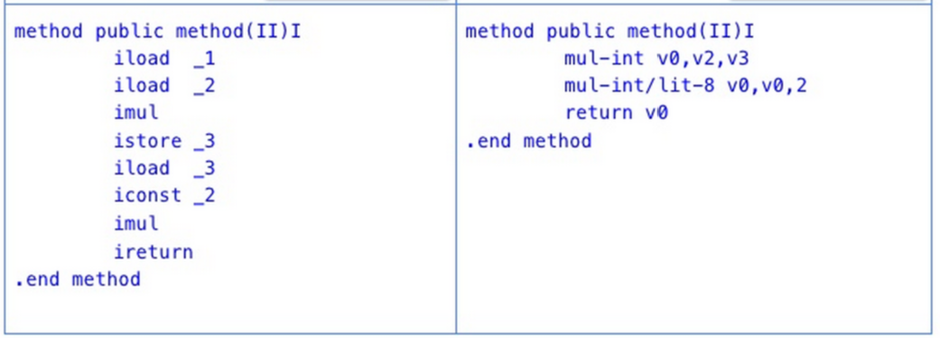
Java Bytecode VS Dex Bytecode
Java Source Code
Java Bytecode
Dalvik Bytecode

Slide 17
Stack-Based Bytecode
Stack-based bytecode.
I1:LOAD C
I2:LOAD B
I3:ADD
I4:STORE A
a = b + c
Register-based bytecode.
a = b + c
I1: add a,b,c
Notes:
But slow

Slide 18
Java Bytecode VS Dex Bytecode
Java Bytecode:
Java Virtual Machine(JVM) runs Java Bytecode.
JVM is Stack-Based.
Java Bytecode is actually more compact than Dex.
Java instructions take 1-5 bytes, Dex take 2-10 bytes.
Dex Bytecode:
Dalvik Virtual Machine runs Dex Bytecode.
Dalvik is Register-based.
Dex Bytecode is more suited to ARM architectures.
Dex supports bytecode optimizations, whereas Java doesn’t.
Notes:
http://blog.csdn.net/u011277123/article/details/68486585

Slide 19
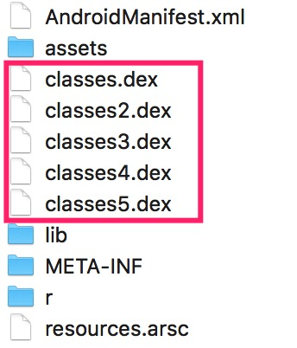
Multi-Dex
Background:
Before Android 5.0, every apk only has one Dex.
If the number of method is bigger than 65535, Compile Error.
The famous “64K”.
What is Multi-dex?
Unzip the famous app Wechat, you will find these:
A solution to slove the limit of 65535.
Notes:
https://developer.android.com/studio/build/multidex.html#about
http://blog.csdn.net/chuyouyinghe/article/details/49153511

Slide 20
4. Smali Code
Smali Definition
Register Naming
Directives
Type of Data
Type Definition
Method Definition
Field Definition
Dalvik Instruction Set

Slide 21
Smali Definition
What is Smali?
.dex <--------> .smali <------- java source code
To edit .dex, we need to convert .dex files to a more understandable form.
Converting a .dex file to smali (called baksmaling) gives us readable code in smali language.
So Smali is the disassembly language of dex.
Notes:
https://forum.xda-developers.com/showthread.php?t=2193735

Slide 22
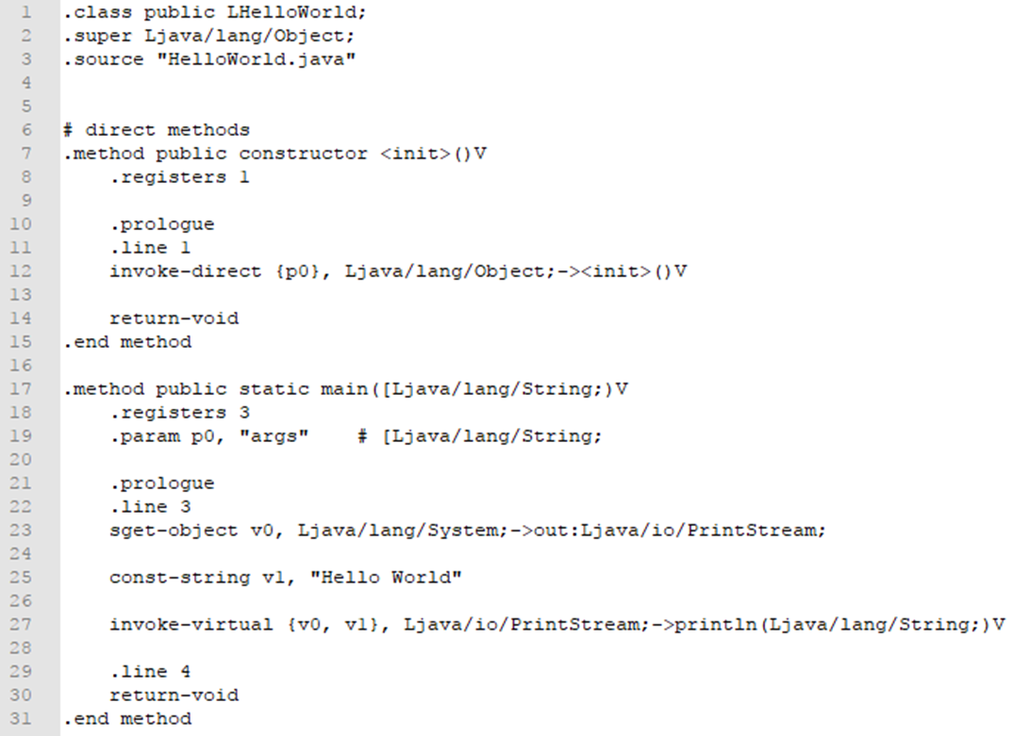
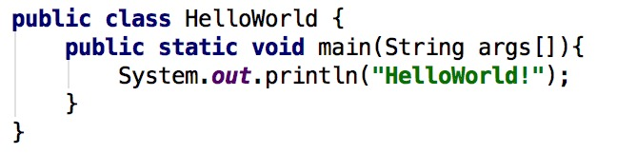
Smali Example
Smali Code
Source Code

Slide 23
Register Naming
Suppose the function has M registers and N parameters:
V Nomenclature | P Nomenclature | Register Meaning
v0 | v0 | The first local variable register
v1 | v1 | The second local variable register
… | … | The numbers increase in turn
vM-N | p0 | The first parameter register
… | … | The numbers increase in turn
vM-1 | pN-1 | The Nth parameter register

Slide 24
Type of Data
Grammar | Meaning
V | void, only used for return value type
Z | boolean
B | byte
S | short
C | char
I | int
J | long
F | float
D | double
L | Java Class type
[ | Array type

Slide 25
Type Definition
L can represent any class in Java
L<PackageName>/<ObjectName>
[ can represent an array of all the basic types
Followed by the basic type descriptor.
L & [ can represent Object array.
Example:
package.name.ObjectName → Lpackage/name/ObjectName;
java.lang.String → Ljava/lang/String;
int[]→ [I
int[] → [[I
String[] → [Ljava/lang/String;
Notes:
The maximum number of [ is 255

Slide 26
Method Definition
Dalvik uses method names, type parameters and return values to describe a method in detail.
Help Dalvik find the right method from the method table quickly.
Dalvik use them to do some static analysis.
Method format
Lpackage/name/ObjectName;->MethodName(III)Z
Example:
method ( I, [[I, I, Ljava/lang/String; [Ljava/lang/Object ;) Ljava/lang/String;
String method(int, int[][], int, String, Object[])

Slide 27
Field Definition
Dalvik uses types, field name and field type to describe a field in detail.
Help Dalvik find the right field from the field table quickly.
Dalvik use them to do some static analysis.
Field names and field types separated by “:”.
Method format
Lpackage/name/ObjectName;->FileName:Ljava/lang/String;
Example:
Lcom/android/Test;->name:Ljava/lang/String;
package com.android;
class Test{String name;}

Slide 28
Dalvik Instruction Set
CONTAINS:
Data Definition
Data Movement
Single/Binary Calculation
Execute Stream Jump
Compare
Method Call /Return
Create Object
Conversion
Field Operations
Array Operation
Abnormal Instruction
Notes:
http://blog.csdn.net/woblog/article/details/52106571

Slide 29
Data Definition
Instruction | Meaning
const/4 vx,lit4 | Save 4-bit literal value lit4(Expanded to 32 bits) into vx
const/16 vx,lit16 | Save 16-bit literal value lit16(Expanded to 32 bits) into vx
const vx,lit32 | Save 32-bit literal value lit32 into vx
const-wide/16 vx,lit16 | Save 16-bit literal value lit16(Expanded to 64 bits) into vx and vx+1
const-wide32/32 vx,lit32 | Save 32-bit literal value lit32(Expanded to 64 bits) into vx and vx+1
const-wide vx,lit64 | Save 64-bit literal value lit64 into vx and vx+1
const/high 16,v0,lit16 | Save 16-bit literal value lit16 into the upper of vx
const-wide/high 16,lit16 | Save 16-bit literal value lit16 into the upper of vx and vx+1
const-string vx,string | Save string into vx
const-class vx,class | Save class into vx

Slide 30
Data Definition Example
Example:
bollean z = true; | const/4 v10, 0x1
z = false; | const/4 v10, 0x0
byte b = 1; | const/4 v0, 0x1
short s = 2; | const/4 v8, 0x2
int i = 3; | const/4 v5, 0x3
long l = 4; | const-wide/16 v6, 0x4
float f = 0.1f; | const v4, 0x3dcccccd #0.1f
double d = 0.2; | const-wide v2, 0x3fc99999999999929aL #0.2
String str = “test”; | const-string v9, “test”
Class c = Object.class; | const-class v1, Ljava/lang/Object;

Slide 31
Data Movement
Instruction | Meaning
move vx,vy | vx = vy
move/from16 vx,vy | vx = vy
move/16 vx,xy | vx = vy
move-wide vx,vy | vx,vx + 1 = vy ,vy +1
move-wide/from16 vx,vy | vx,vx + 1 = vy ,vy +1
move-wide/16 vx,vy | vx,vx + 1 = vy ,vy +1
move-object vx,vy | vx = vy
move-object/from16 vx,vy | vx = vy
move-object/16 vx,vy | vx = vy
move-result vx | Assign the return value of basic types (int etc) less than or equal to 32 bits to vx
move-result-wide vx | Assign long and double type return values to vx
move-result-object vx | Assign the return value of the object type to vx
move-exception vx | Assign the exception object to vx,but can only be used after “throw”

Slide 32
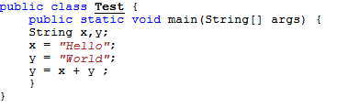
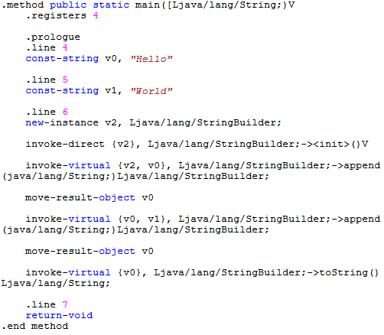
Data Movement Example
Example:

Slide 33
Single Calculation
Instruction | Operation type | Meaning
Arithmetic Operation
neg- vx ,vy | Take the opposite | vx = -vy
Bit Operation
not- vx,vy | Take the complementary | vx = ~vy
Example:
int a = 5; | const/4 v0,0x5;
b = -a; | neg-int v1,v0;
c = ~a; | not-int v2,v0

Slide 34
Binary Calculation
Instruction | Operation type | Meaning
Arithmetic Operation
add -/2addr vx,vy | Add assignment | vx += vy
sub-/2addr vx,vy | Subtraction assignment | vx -= vy
mul-/2addr vx,vy | Multiplication assignment | vx *= vy
div-/2addr vx,vy | Division assignment | vx /= vy
rem-/2addr vx,vy | Remainder assignment | vx %= vy
Bit Operation
add-/2addr vx,vy | And assignment | vx &= vy
or-/2addr vx,vy | Or assignment | vx |= vy
xor -/2addr vc,vy | XOR assignment | vx ^= vy
shl-/2addr vx,vy | Left shift assignment | vx <<= vy
shr-/2addr vx,vy | Right shift assignment | vx >>= vy
ushr-/2addr vx,vy | Unsigned logical right shift assignment | vx >>>= vy

Slide 35
Binary Calculation Example
Example:
int a = 5, b = 2; | const/4 v0, 0x5 const/4 v1, 0x2
a += b; | add-int/2addr v0,v1
a -= b; | sub-int/2addr v0, v1
a *=b; | mul-int/2addr v0, v1
a /=b; | div-int/2addr v0, v1
a %=b; | rem-int/2addr v0, v1
a &=b; | and-int/2addr v0, v1
a |= b ; | or-int/2addr v0, v1
a ^= b; | xor-int/2addr v0, v1
a <<= b; | shl-int/2addr v0, v1
a >>= b; | shr-int/2addr v0, v1
a >>>= b; | ushr-int/2addr v0, v1

Slide 36
Unconditional Jump
Java don’t have goto, but Smali have.
The possibility of cooperation with if and for large.
Can used for code obfuscation.
Instruction | Type
goto target | 8-bit unconditional jump
goto/16 target | 16-bit unconditional jump
goto/32 target | 32-bit unconditional jump

Slide 37
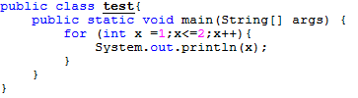
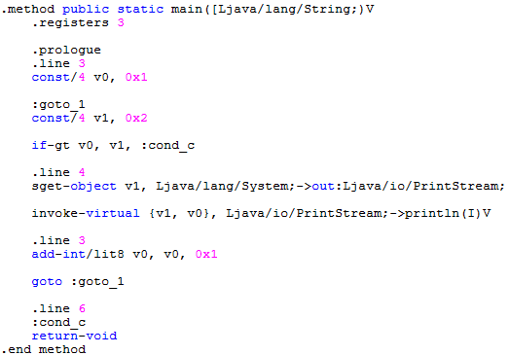
Unconditional Jump Example
Example:

Slide 38
Conditional Jump
Instruction | Meaning
if-eq vx,vy,target | vx == vy, jump to target
if-ne vx,vy,target | vx != vy, jump to target
if-lt vx,vy,target | vx < vy, jump to target
if-gt vx,vy,target | vx > vy, jump to target
if-ge vx,vy,target | vx >= vy, jump to target
if-le vx,vy,target | vx <= vy, jump to target
if-eqz vx,target | vx == 0, jump to target
if-nez vx,target | vx != 0, jump to target
if-ltz vx,target | vx < 0, jump to target
if-gtz vx,target | vx > 0, jump to target
if-gez vx,target | vx >= 0, jump to target
if-lez vx,target | vx <= 0, jump to target

Slide 39
Conditional Jump Example
Example:
int a = 10; if( a > 0 ) a = 1; | const/4 v0, 0xa if-lez v0, :cond_0 const/4 v0, 0x1 :cond_0

Slide 40
Compare
Instruction | Meaning
cmpl-float vx,vy,vz | vx = -sgn(vy -vz)
cmpg-float vx,vy,vz | vx = sgn(vy -vz)
cmp-float vx,vy,vz | vx = sgn(vy -vz)
cmpl-double vx,vy,vz | vx = -sgn(vy -vz)
cmpg-double vx,vy,vz | vx = sgn(vy -vz)
cmp-double vx,vy,vz | vx = sgn(vy -vz)
cmp-long vx,vy,vz | vx = sgn(vy -vz)
if x > 0, y = 1;
if x = 0, y = 0;
if x < 0, y = -1
y = sgn(x)

Slide 41
Method Call/Return
Instruction | Meaning
Method call
invoke-static | Call the static method
invoke-direct | Call the direct method
invoke-direct-empty | No parameters invoke-direct
invoke-virtual | Call the virtual method
invoke-super | Call the instance's parent class method
invoke-interface | Call the instance's interface method
Method return
return-void | The function is returned from a void method
return vx | Function returns a 32-bit value of a non-object type
return-wide vx | Function returns a 64-bit value of a non-object type
return-object vx | Function returns the value of an object type

Slide 42
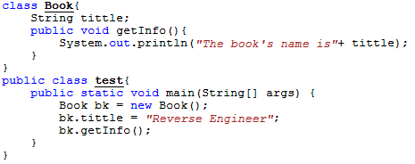
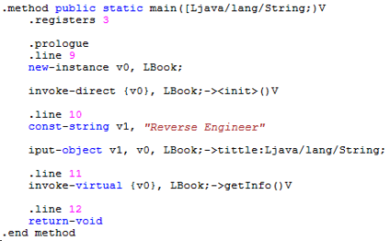
Method Call/Return Example
Example:

Slide 43
Create Array
Instruction | Meaning
new-array vx,vy, data_type | The type of array is data_type, size is vy, Assigned to vx
filled-new-array {params}, type_id | Create an array from params, use move-result to get results
filled-new-array-range {vx,vy}, type_id | Create an array from all the registers between vx and vy, use move-result to get results
Example:
int [] arr = new int[10]; | const/4 v1,0xa; new-array v0, v1, I
int [] arr = {1, 2, 3, 4, 5}; | const/4 v1, 0x1 const/4 v2, 0x2 const/4 v3, 0x3 const/4 v4,0x4 const/4 v5,0x5 filled-new-array {v1,v2,v3,v4,v5}, I move-result v0

Slide 44
Create the Object
Instruction | Meaning
new-instance vx, type | The type of instance is type, Assigned to vx
Example:
Object obj = new Object(); | new-instance v0, Ljava/lang/Object; invoke-direct-empty {v0}, Ljava/lang/Object;-><init>()V
Notes:
Need to call the constructor <init>

Slide 45
Object Conversion
Instruction | Meaning
instance-of vx, vy, data_type | Test if the type of vy is data_type, save the result into vx
check-cast vx, data_type | Test if the type of vx is data_type , if not ,throw ClassCastException
Example:
String s = “test”; boolean b = s instanceof String; | const-string v0, “test” instance-of v1, v0 , Ljava/lang/String;
String s = “test”; Object o = (Object)s; | const-string v0, “test” check-cast v0, Ljava/lang/Object; move-object v1, v0
Notes:
check-cast is used to cast the object type

Slide 46
Static Field Operation: sget
sget : used to get static fields.
Instruction | Meaning
sget vx, type->field:field_type | vx = class.field
sget-wide vx, type->field:field_type | vx = class.field
sget-object vx, type->field:field_type | vx = class.field
sget-boolean vx, type->field:field_type | vx = class.field
sget-byte vx, type->field:field_type | vx = class.field
sget-char vx, type->field:field_type | vx = class.field
sget-short vx, type->field:field_type | vx = class.field

Slide 47
Static Field Operation: sput
sput : used to set static fields.
Instruction | Meaning
sput vx, type->field:field_type | class.field = vx
sput-wide vx, type->field:field_type | class.field = vx
sput-object vx, type->field:field_type | class.field = vx
sput-boolean vx, type->field:field_type | class.field = vx
sput-byte vx, type->field:field_type | class.field = vx
sput-char vx, type->field:field_type | class.field = vx
sput-short vx, type->field:field_type | class.field = vx

Slide 48
sget/sput Example
Example:
public static int getStaticField(){ return staticField; } | sget v0, Lnet/android/myapplication/Test;->staticField:I return v0
public static void setStaticField(int staticField){ Test.staticField = staticField; } | sput p0, Lnet/android/myapplication/Test;->staticField:I return-void

Slide 49
Member Field Operation: aget
aget : used to read the array element.
Instruction | Meaning
aget vx, vy, vz | vx = vy[vz]
aget-wide vx, vy, vz | vx = vy[vz]
aget-object vx, vy, vz | vx = vy[vz]
aget-boolean vx, vy, vz | vx = vy[vz]
aget-byte vx, vy, vz | vx = vy[vz]
aget-char vx, vy, vz | vx = vy[vz]
aget-short vx, vy, vz | vx = vy[vz]

Slide 50
Member Field Operation: aput
aput : used to write array element.
Instruction | Meaning
aput vx, vy, vz | vy[vz] = vx
aput-wide vx, vy, vz | vy[vz] = vx
aput-object vx, vy, vz | vy[vz] = vx
aput-boolean vx, vy, vz | vy[vz] = vx
aput-byte vx, vy, vz | vy[vz] = vx
aput-char vx, vy, vz | vy[vz] = vx
aput-short vx, vy, vz | vy[vz] = vx

Slide 51
aget/aput Example
Example:
int[] arr = new int[2]; int b = arr[0]; arr[1] = b; | const/4 v0, 0x2 new-array v1, v0, I const/4 v0, 0x0 aget-int v2, v1, v0 const/4 v0, 0x1 aput-int v2, v1, v0

Slide 52
Abnormal Instruction
Instruction | Meaning
throw vx | Throw abnormal information of the specified type in vx register
Three ways to solve the abnormal:
Try-catch
Try-finally
Try-catch-finally

Slide 53
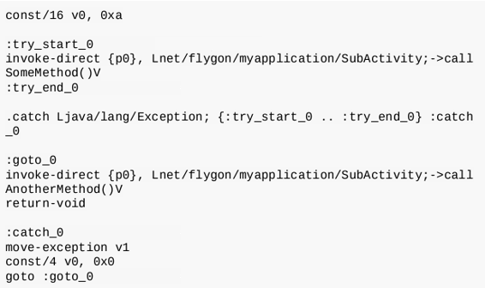
Try-catch
Example:
int a = 10; try{ callSomeMethod(); } catch (Exception e){ a = 0; } callAnotherMethod();
Notes:
If the code between :try_start_0 and :try_end_0 has abnormal information,
It will look for a .catch (or .catch-all) statement,
jumping to the label when the condition is met,
here is: catch_0, after the end there will be a goto jump back.

Slide 54
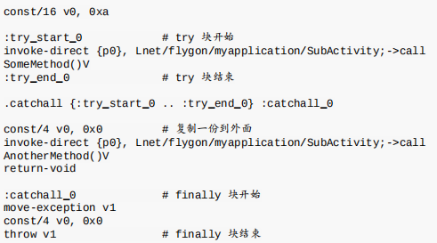
Try-finally
Example:
int a = 10; try{ callSomeMethod(); } finally{ a = 0; } callAnotherMethod();
#try start
#try end
#Copy one copy to the outside
#finally start
#finally end
Notes:
The finally is compiled into .catch-all
The logic in finally executes without exception, so need to copy one to put behind the finally block.

Slide 55
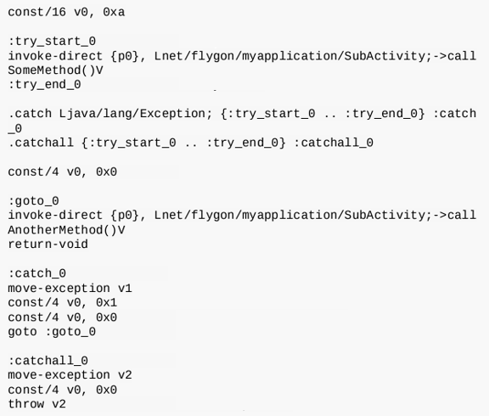
Try-catch-finally
Example:
int a = 10; try{ callSomeMethod(); }catch (Exception e){ a = 1; } finally{ a = 0; } callAnotherMethod();
#try start
#try end
#Copy one copy to the outside
#catch start
#Copy a copy into the catch
#catch end
#catch end
#finally end
Notes:
Contains . Catch block and . Catchall block at the same time.
The difference is that the abnormal in the finally block should also be executed.
If the finally compiled into .catch-all ,then it will mutually exclusive with .catch.
So need to copy one into the catch.

Slide 56
5. Tools
Decompile
Smali/ Baksmali
Dex2jar & jd-gui
Dexdump
JEB
Jadx
GDA
AXmlPrinter
ApkTool
Repackaging & Signing
ApkTool
Classy Shark
Jarsigner

Slide 57
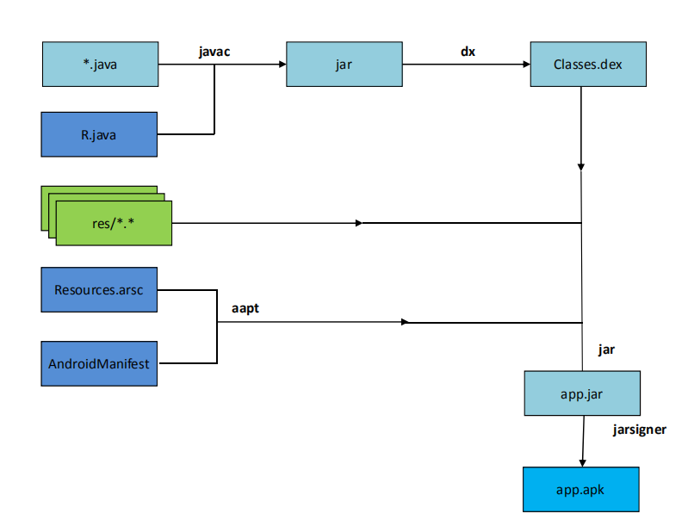
Reminder: Creating an APK

Slide 58
Smali/ Baksmali
Smali/baksmali is an assembler/disassembler for the dex format used by Dalvik.
The syntax supports the full functionality of the dex format (annotations, debug info, line info, etc.)
Smali2dex:
Turn Smali into Dex.
Command:
java –jar smali-2.x.x.jar –o target.dex [File folder]
Dex2smali:
Turn Dex into Smali.
Command:
java –jar baksmali-2.x.x.jar –o [File folder] origin.dex

Slide 59
Dex2jar
Tools to work with android .dex and java .class:
Dex-reader/writer: Read/write the Dalvik Executable (.dex) file.
d2j-dex2jar: Convert .dex file to .class files (zipped as jar).
smali/baksmali: disassemble dex to smali files and assemble dex from smali files.
Command:
sh d2j-dex2jar.sh -f ~/path/to/apk_to_decompile.apk

Slide 60
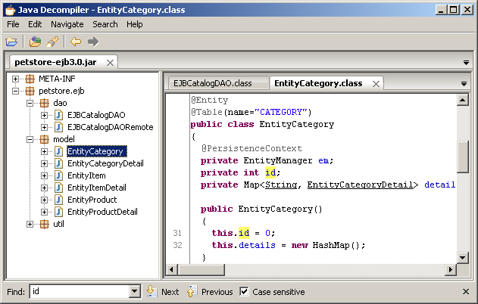
Jd-gui
A standalone graphical utility that displays Java sources from CLASS files.
Browse the reconstructed source code with the JD-GUI for instant access to methods and fields.

Slide 61
Dexdump
The tool to view DEX Files by turning DEX into txt.
Command:
dexdump.exe –d origin.dex > target.txt

Slide 62

JEB
Excellent anti-compiler software.
Unique feature:
The Dalvik bytecode anti-compiled into Java source code.
It has powerful user interface.
It can fully test the APK file content.
Support for Windows, Linux and Mac OS.

Slide 63
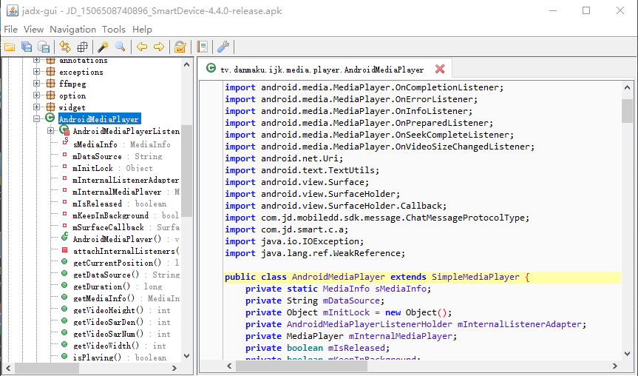
Jadx
Command line and GUI tools for produce Java source code from Android Dex and Apk files.
Support global class search、global text query.
Support export gradle project.
Notes:
Dex to Java decompiler

Slide 64
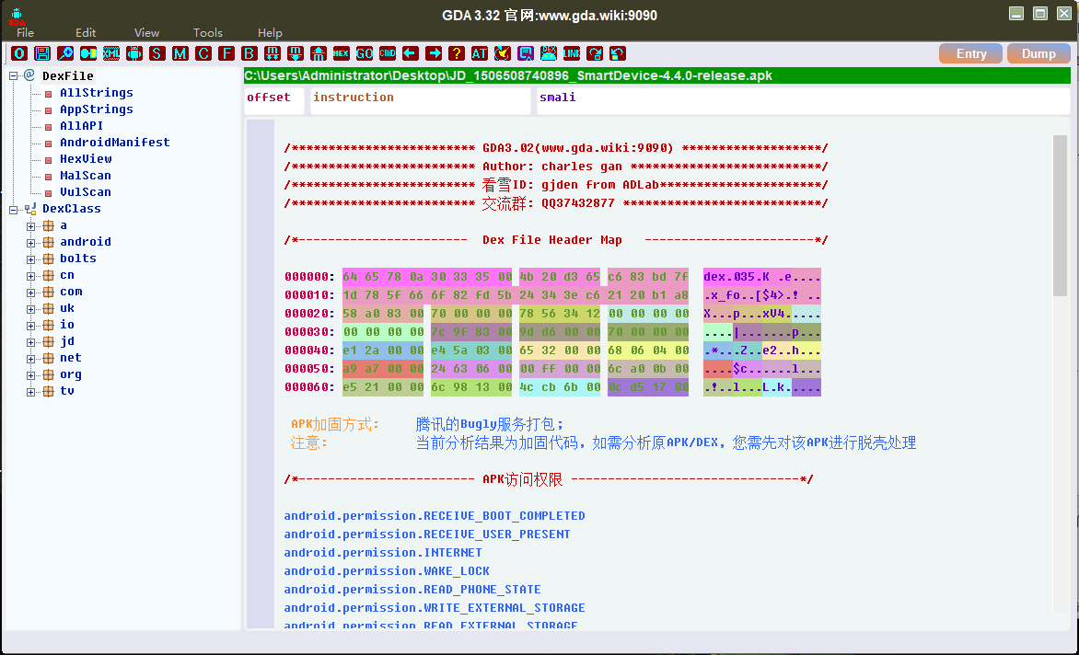
GDA
All functions are written in C ++.
Don’t need java & android environment.
Support analysis APK, DEX, ODEX, OAT files.

Slide 65
AXmlPrinter
It is a heavily refactor of the Android4ME axmlprinter library/code.
Library for parsing and printing compiled Android manifest files.
Command:
Java –jar AXMLPrinter2.jar
Notes:
android4me: J2ME port of Google's Android

Slide 66
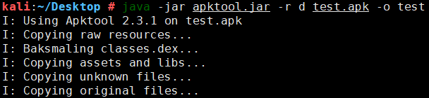
Apktool
A tool for reverse engineering 3rd party, closed, binary Android apps.
It can decode resources to nearly original form.
Command:
apktool d [-s] -f <apkPath> -o <folderPath>
Notes:
It makes working with an app easier because of the project like file structure and automation of some repetitive tasks like building apk, etc.
https://github.com/iBotPeaches/Apktool
https://www.cnblogs.com/mliangchen/p/5084961.html

Slide 67
Re-package
What is Re-package?
To add, delete or modify some functions of the Apk, we change some resources or code, then recompile and generate the new Apk.
The process of Re-package:
Decompile the Apk.
Replace the relevant documents, eg pictures.
Modify the relevant code according to smali、dex.
Generate new Apk.

Slide 68
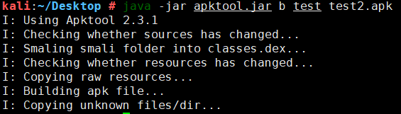
Apktool
Apktool can not only decode but also rebuild after making some modifications.
Command:
apktool b <folderPath>foldername xxxx.apk

Slide 69
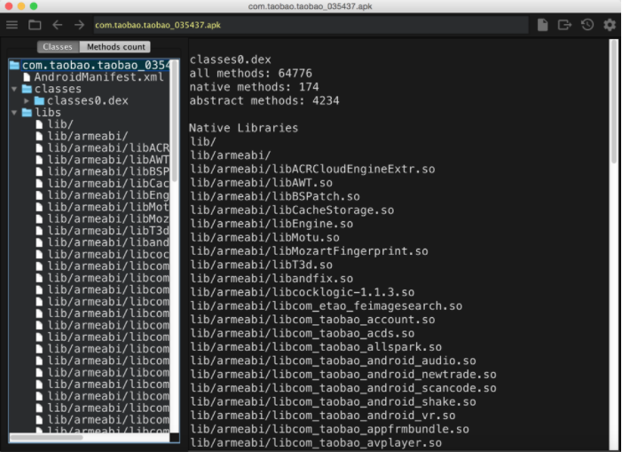
ClassyShark
A standalone binary inspection tool.
It can reliably browse any Android executable and show important info such as class interfaces and members, dex counts and dependencies.
Support .dex, .so, .apk, .jar, .class, .xml and other.
Notes:
(https://github.com/google/android-classyshark)

Slide 70
ClassyShark vs ApkTool
ClassyShark
Advantage:
Very easy to use, just a command line to arouse the interface.
The source directory structure is clear, we can graphically view the composition of the entire APK architecture.
Disadvantages:
Source code is too simple, can not get the appropriate code logic.
Can not get to the resource file.
ApkTool
Advantage:
Can get more complete set of resource files.
The source code is clear.
Disadvantage:
Need more tools to work together.
Can not better view the entire apk architectural logic.

Slide 71
Jarsigner
After re-package, the apk is still unable to install. It needed to be signed.
The jarsigner tool has two purposes:
To sign Java Archive (JAR) files.
To verify the signatures and integrity of signed JAR files.
Command:
jarsigner -verbose –keystore A.keystore –signedjar target.apk

